Slide 1
Symmetric Ciphers
Engr.Ayesha Arshad

Slide 2
Basic Terminologies
Plaintext: the original intelligible message.
Ciphertext: the coded unintelligible message.
Encryption: the process of converting plaintext to ciphertext.
Decryption: the process of restoring plaintext from ciphertext.
Cryptanalysis: Techniques used for deciphering a message without any knowledge of enciphering detail.

Slide 3
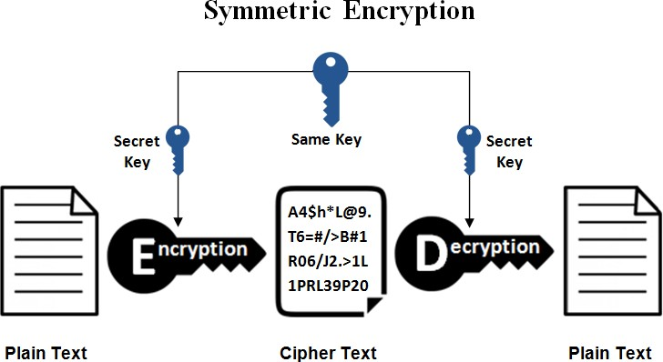
Cryptographic Algorithms
Cryptographic algorithms can be grouped into:
Symmetric-key Algorithms: cryptography algorithms that use the same cryptographic keys for both encryption and decryption.

Slide 4
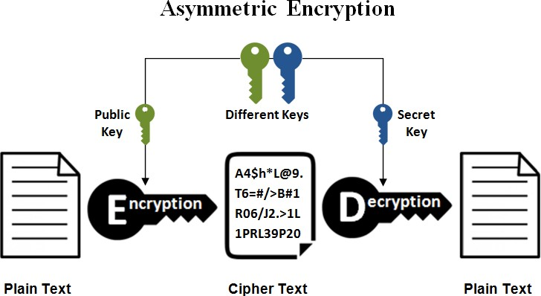
Cryptographic Algorithms (Cont.)
Cryptographic algorithms can be grouped into:
2. Asymmetric-key Algorithms: cryptography algorithms that uses pairs of keys, i.e. public keys and private keys, to encrypt and decrypt data.

Slide 5
Cryptographic Algorithms (Cont.)
Symmetric Encryption is used to conceal the contents of blocks or streams of data of any size, including messages, files, encryption keys and passwords.
Asymmetric Encryption is used to conceal small blocks of data, such as encryption keys and hash function values, which are used in digital signatures.

Slide 6
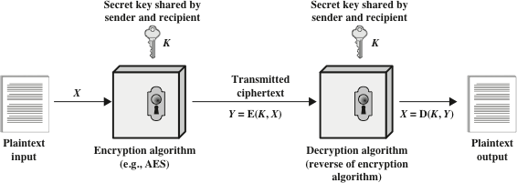
Symmetric Encryption
A general model for the symmetric encryption

Slide 7
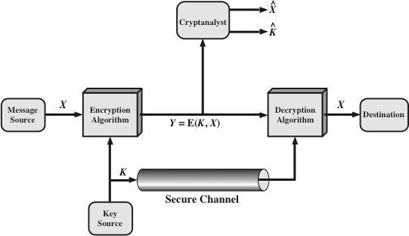
Symmetric Encryption (Cont.)

Slide 8
Symmetric Encryption (Cont.)
Properties of secret key in symmetric encryption:
The key is input to encryption algorithm along with plaintext.
The key is a value independent of the plaintext and the algorithm.
The algorithm will produce a different output depending on the specific key being used. Hence, for a given message, two different keys will produce two different cipher texts.
The encryption algorithm performs various substitutions and transpositions on the plaintext, where the exact substitutions and transpositions depends on the key.

Slide 9
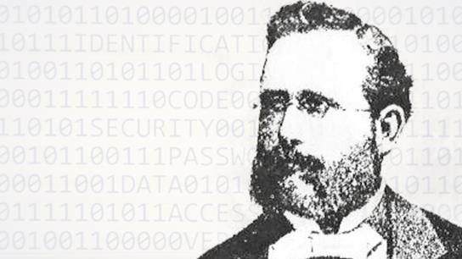
Symmetric Encryption (Cont.)
Kerckhoff’s principle: one should always assume that the adversary knows the encryption/decryption algorithm. The resistance of the cipher to attack must be based only on the secrecy of the key.

Slide 10
Symmetric Encryption (Cont.)
Symmetric Encryption Features:
It is “impractical” to decrypt a message on the basis of ciphertext plus knowledge of encryption/decryption algorithm.
There is no need to keep the algorithm secret; but only keep the key secret. This feature makes symmetric key feasible for widespread use. Hence, manufacturers can and have developed low-cost chip implementations of data encryption algorithms.
With the use of symmetric encryption, the principal security problem is maintaining the secrecy of the key.

Slide 11
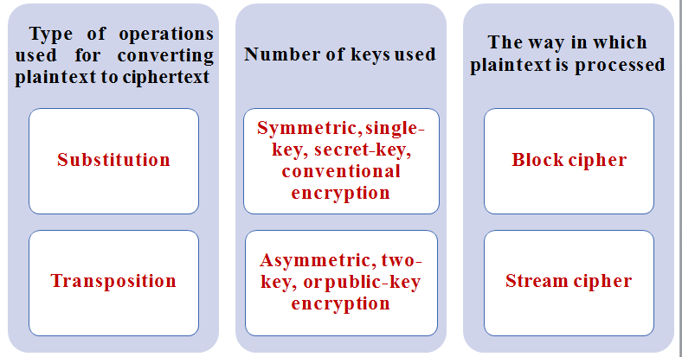
Cryptographic Systems
Cryptographic systems are characterized by three dimensions:

Slide 12
Cryptographic Systems (Cont.)
Type of operations used for transforming plaintext to ciphertext:
All encryption algorithms are based on two general principles:
Substitution: In which each element in the plain text (bit, letter, group of bits or letters) is mapped into another element.
Transposition: In which elements in the plaintext are rearranged.

Slide 13
Cryptographic Systems (Cont.)
The way in which the plaintext is processed:
Block cipher processes the input one block of elements at a time, producing an output block for each input block.
Stream cipher processes the input elements continuously, producing output one element at a time, as it goes along.

Slide 14

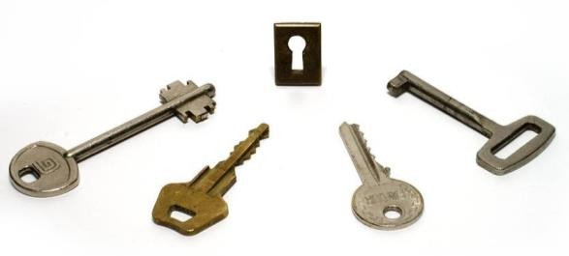
Cryptanalysis and Brute-Force
There are two general approaches for attacking a conventional encryption scheme:
Cryptanalysis, rely on nature of the algorithm plus some general characteristics of plaintext or plaintext–ciphertext pairs. This attack attempts to deduce a specific plaintext or the key being used.
Brute-force attack, the attacker tries every possible key on a piece of ciphertext until an intelligible translation is obtained. On average, half of all possible keys must be tried to achieve success!

Slide 15
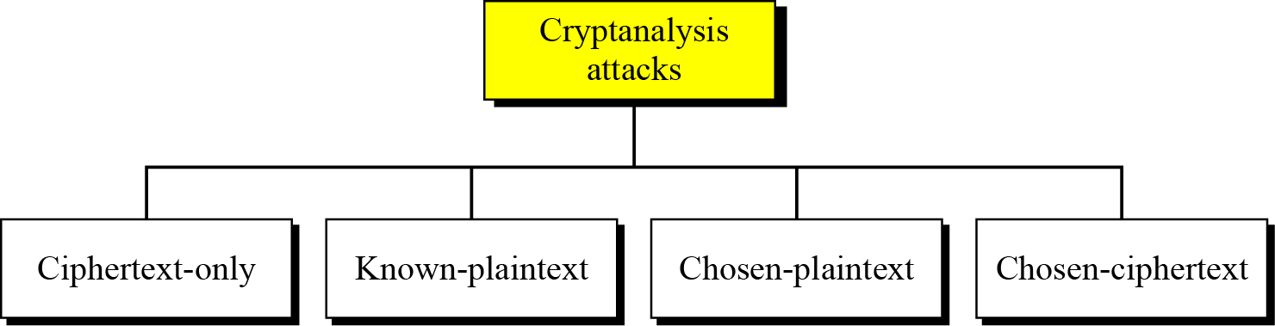
Cryptanalysis
As cryptography is the science and art of creating secret codes,
cryptanalysis is the science and art of breaking those codes.
There are four common types of cryptanalysis attacks based on the amount of information known to the cryptanalyst:

Slide 16
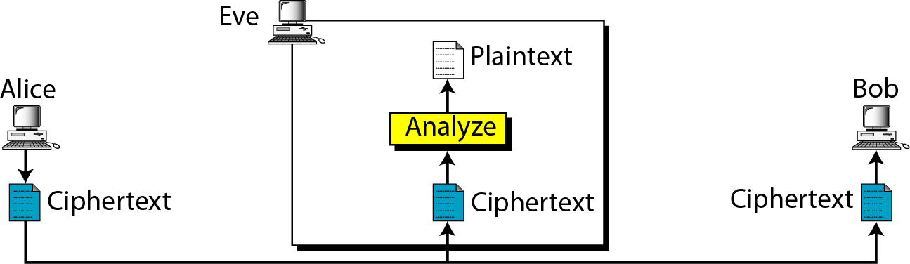
Ciphertext-only Attack
The adversary has access to some ciphertext and tries to find the corresponding key or plaintext.
This is the most difficult attack for cryptanalyst since ciphertext is all that is available (note: in some cases, not even the encryption algorithm is known!).

Slide 17
Ciphertext-only Attack (Cont.)
Various methods can be used in ciphertext-only attack. The three most common are:
Brute-Force Attack, an exhaustive key search method. To prevent this type of attack, the number of possible keys must be very large.
Statistical Attack, use of inherent characteristic of the language, e.g. English or French.
Pattern Attack, make use of patterns in ciphertext.

Slide 18
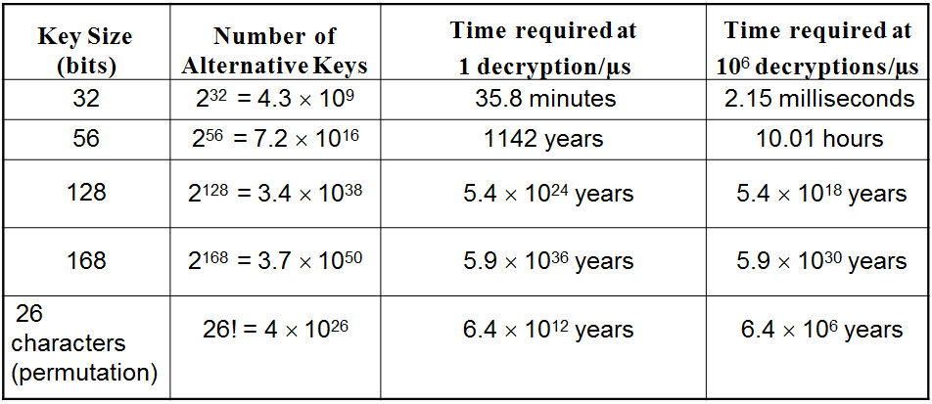
Ciphertext-only Attack (Cont.)
In brute-force attack, the attack is proportional to key size.

Slide 19
Encryption Scheme Security Requirement
Unconditionally secure:
No matter how much time an opponent has, it is “impossible” for him/her to decrypt the ciphertext since the required information is not there.
Computationally secure:
The “cost” of breaking the cipher exceeds the value of the encrypted information.
The “time” required to break the cipher exceeds the useful lifetime of the information.

Slide 20
Substitution Technique

Slide 21
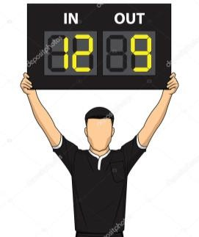
Substitution Technique
Techniques in which the letters of plaintext are replaced by other letters, numbers or symbols.
If the plaintext is viewed as a sequence of bits, then substitution involves replacing plaintext bit patterns with ciphertext bit patterns.
Substitution cipher can be categorized as either monoalphabetic cipher or polyalphabetic cipher.

Slide 22
Monoalphabetic Ciphers
In monoalphabetic substitution, the relationship between a symbol in the plaintext to a symbol in the ciphertext is always one-to-one.
Example: the following shows a plaintext and its corresponding ciphertext. The cipher is monoalphabetic because both l’s are encrypted as O’s.

Slide 23
Caesar Cipher
Caesar cipher is a monoalphabetic cipher that involves replacing each letter of alphabet with that standing 3 places further down the alphabet, where alphabet is wrapped around so the letter following Z is A.
The shift may be of any amount, so the general Caesar cipher is called an additive cipher.

Slide 24
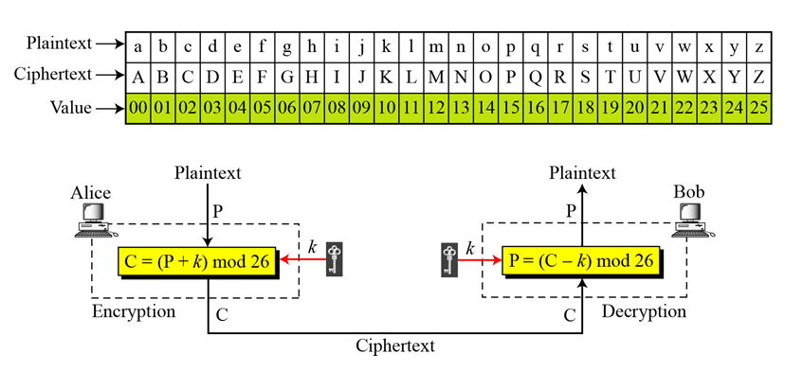
Additive Cipher

Slide 25
Additive Cipher (Cont.)
The plaintext, ciphertext and key are integers in Z₂₆.
The general algorithm is:
C = E(k , P ) = (P + k ) mod 26
The decryption algorithm is simply:
P = D(k , C ) = (C - k ) mod 26
Where, k takes on a value in the range 1 to 25).
With k = 0, ciphertext is same as plaintext. Hence, only 25 keys are useful.

Slide 26
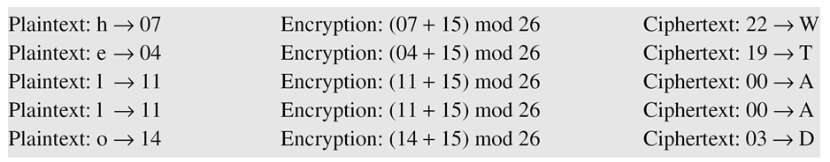
Additive Cipher (Cont.)
Example 01: use the additive cipher with k = 15 to encrypt the message “hello”.
Solution:

Slide 27
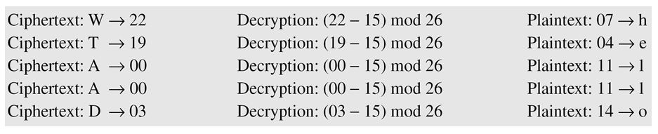
Additive Cipher (Cont.)
Example 02: use the additive cipher with k = 15 to decrypt the message “WTAAD”.
Solution:

Slide 28
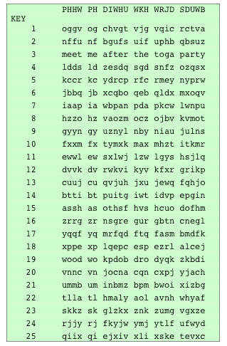
Additive Cipher (Cont.)
If it is known that a given ciphertext is an Additive cipher, then brute- force cryptanalysis is easily performed.
Simply try all the 25 possible keys.
In this example, the plaintext leaps out as occupying the third line.
Note: with only 25 possible keys, the Caesar cipher is far from secure.

Slide 29
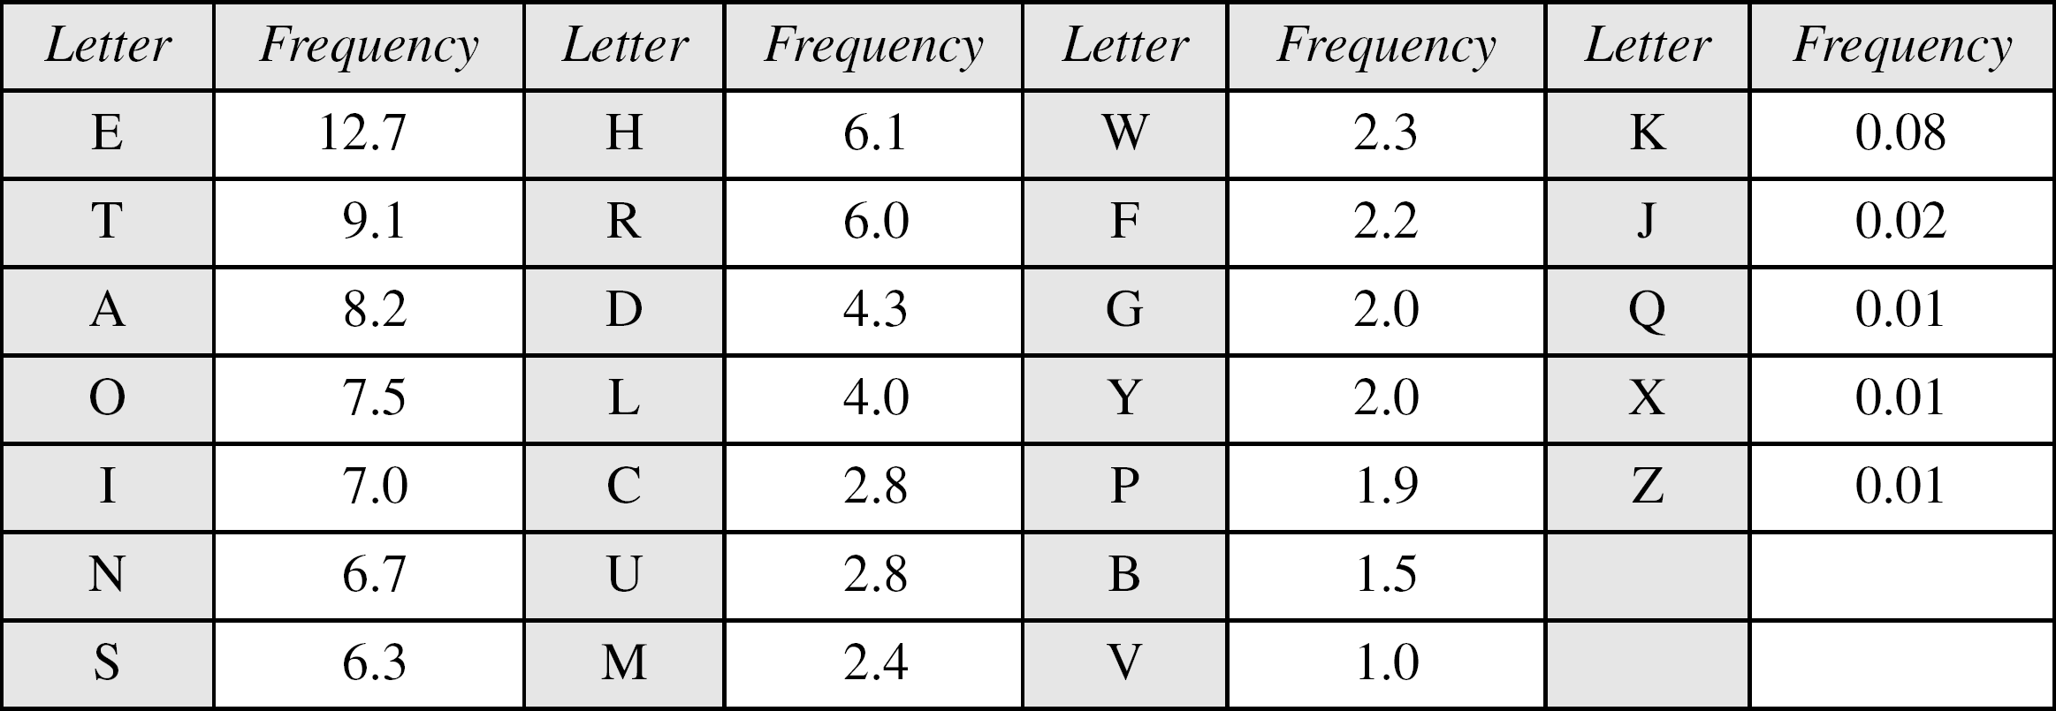
Cryptanalysis in Additive Cipher
Frequency of characters in English:

Slide 30
Cryptanalysis in Additive Cipher (Cont.)
Example: the attacker has intercepted the following ciphertext. Using a statistical attack, find the plaintext.
Solution: after tabulating the frequency of letters in this ciphertext, we get: I =14, V =13, S =12, and so on. The most common character is I with 14 occurrences. This means key = 4.

Slide 31
Polyalphabetic Ciphers
In polyalphabetic substitution, each occurrence of a character may have a different substitute.
The relationship between a character in plaintext to a character in ciphertext is one-to-many.
E.g. “a” could be enciphered as “D” at beginning of text, but as “N” at the middle.
Benefit of polyalphabetic ciphers:
Hides letter frequency of the language.
Cannot use frequency statistics to break the ciphertext.

Slide 32
Polyalphabetic Ciphers (Cont.)
We need to make each ciphertext character dependent on both corresponding plaintext character and position of plaintext character in the message.
The key should be a stream of subkeys, i.e.
𝒌 = {𝒌_{𝟏}, 𝒌_{𝟐}, 𝒌_{𝟑}, …}

Slide 33
Hill Cipher
The plaint text is divided into equal-size blocks that are encrypted one at a time, where m is the size of the block.
Each character in a block contributes to the encryption of other characters in the block.
Hill cipher algorithm takes m successive plaintext letters and substitutes by m ciphertext letters.
The key is a square matrix of size m × m.

Slide 34
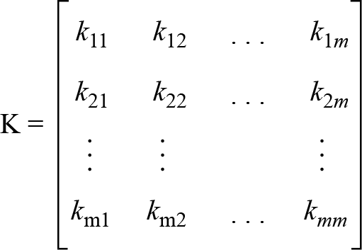
Hill Cipher (Cont.)
Key in Hill cipher:
The key matrix needs to have a multiplicative inverse, where not all square matrices do in Z₂₆.

Slide 35
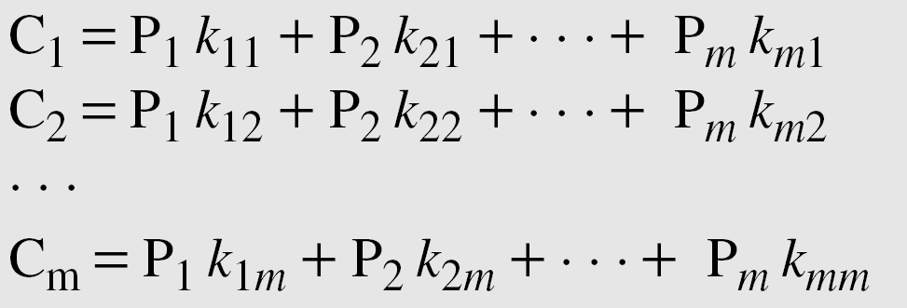
Hill Cipher (Cont.)
Substitution is determined by m linear equations.
If we call m characters in plaintext block P₁, P₂, … , P_{m}, the corresponding characters in ciphertext block are C₁, C₂, … , C_{m}.
Each ciphertext character depends on all plaintext characters.

Slide 36
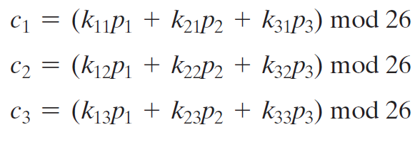
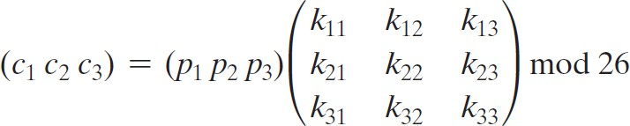
Hill Cipher (Cont.)
E.g. for m = 3, the system can be described as:
This can be expressed in terms of row vectors and matrices as:
C = PK mod 26

Slide 37
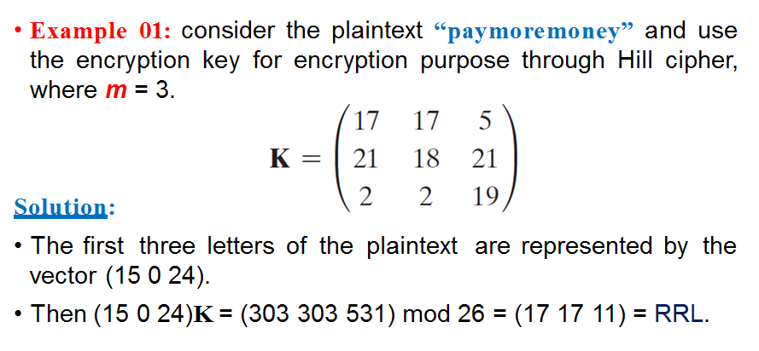
Hill Cipher (Cont.)

Slide 38
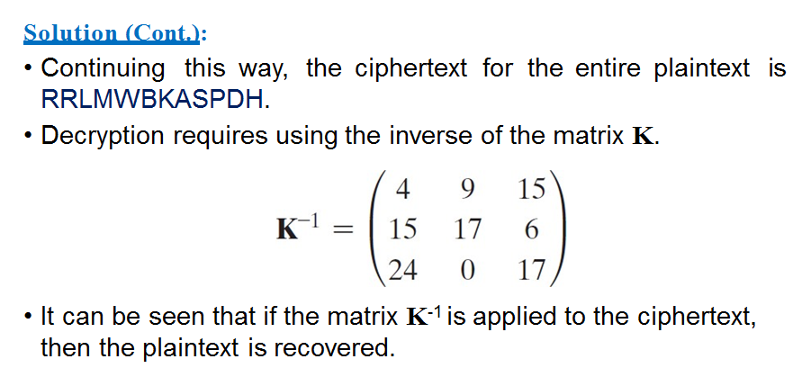
Hill Cipher (Cont.)

Slide 39
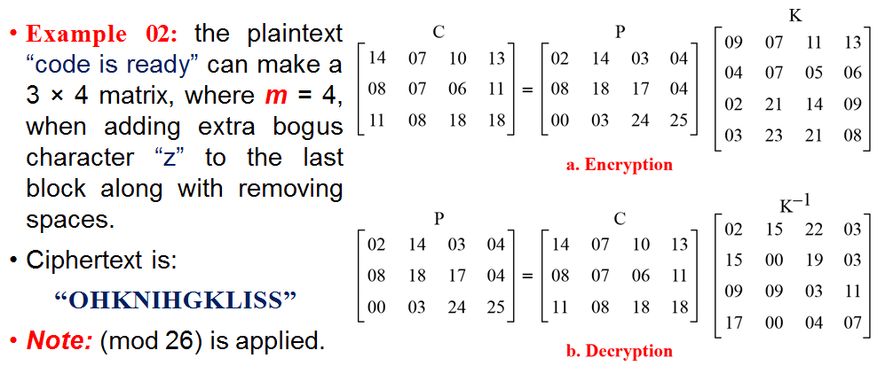
Hill Cipher (Cont.)

Slide 40
Hill Cipher (Cont.)
Hill Cipher Benefits:
It completely hides single-letter frequencies.
The use of a larger matrix hides more frequency information.
A 3 × 3 Hill cipher hides not only single-letter but also two- letter frequency information.
Hill cipher is strong against a ciphertext-only attack.

Slide 41
Hill Cipher Cryptanalysis
Hill cipher is easily broken with a known plaintext attack.
We define two m × m matrices X = (p_{ij}) and Y = (c_{ij}). Then, we can form the matrix equation Y = XK.
If X has an inverse, then we can determine K = X⁻¹Y.
If X is not invertible, then a new version of X can be formed with additional plaintext–ciphertext pairs until an invertible X is obtained.

Slide 42

Hill Cipher Cryptanalysis (Cont.)
Example: suppose the plaintext “hillcipher” is encrypted using a 2 × 2 Hill cipher to yield the ciphertext “HCRZSSXNSP”.
We know by capturing the plaintext-ciphertext pairs that:
(7 8)K mod 26 = (7 2)
(11 11)K mod 26 = (17 25); and so on.
Using the first two plaintext-ciphertext pairs, we have:

Slide 43
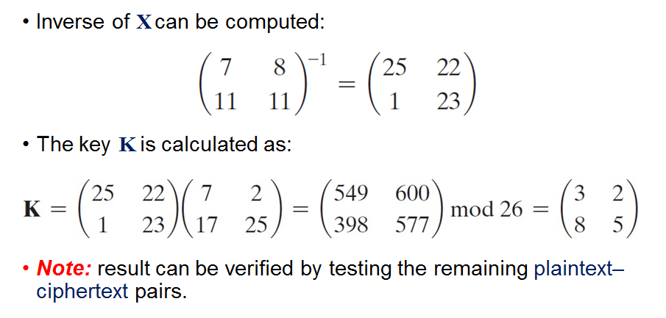
Hill Cipher Cryptanalysis (Cont.)

Slide 44
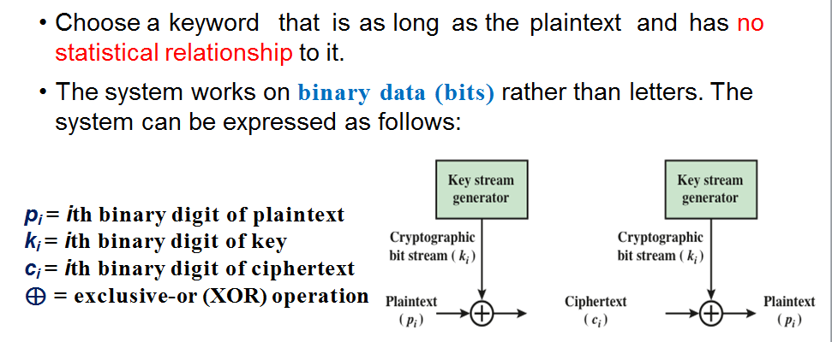
Vernam Cipher

Slide 45
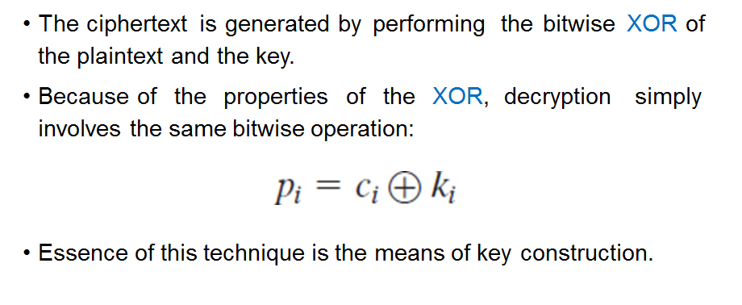
Vernam Cipher (Cont.)

Slide 46
One-Time Pad
An improvement to the Vernam cipher.
Use a random key that is as long as the message so that the key need not be repeated.
Key is used to encrypt and decrypt a single message and then is discarded.
Each new message requires a new key of the same length as the new message.

Slide 47
One-Time Pad (Cont.)
Advantage of One-Time Pad:
Produces random output that bears no statistical relationship to the plaintext.
The ciphertext contains no information whatsoever about the plaintext, hence there is simply no way to break the code.
Disadvantage of One-Time Pad:
Problem of making large quantities of random keys.
Key distribution problem, where for every message, a key of equal length is needed at both sender and receiver.

Slide 48
Transposition Technique

Slide 49
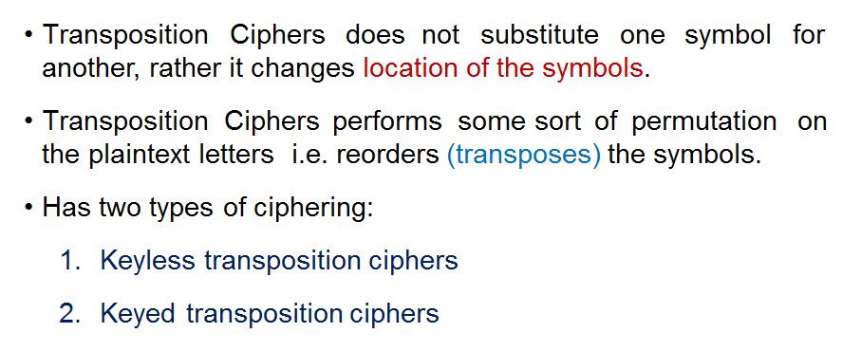
Transposition Ciphers

Slide 50
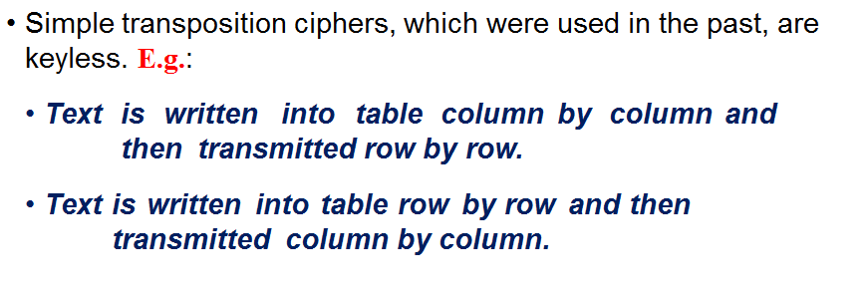
Keyless Transposition Ciphers

Slide 51
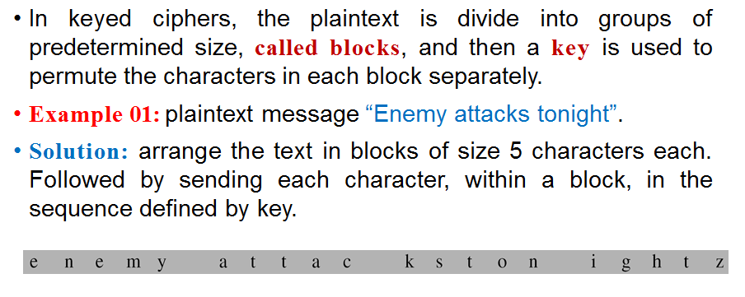
Keyed Transposition Ciphers

Slide 52
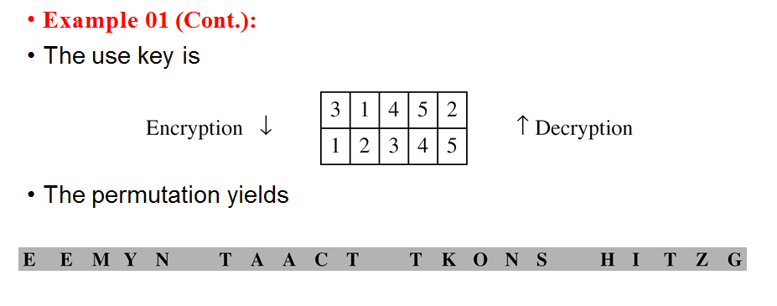
Keyed Transposition Ciphers (Cont.)

Slide 53
Columnar Transposition Ciphers
To achieve better scrambling, we can combine the two approaches (Keyless & Keyed).
Below is an example in which the following steps are followed:
Text is written into table row by row.
Permutation is done by reordering the columns, i.e. according to the provided key.
A new table is read column by column.
Note: the 1st and 3rd steps provide a keyless reordering, while the second step provides a keyed reordering.

Slide 54
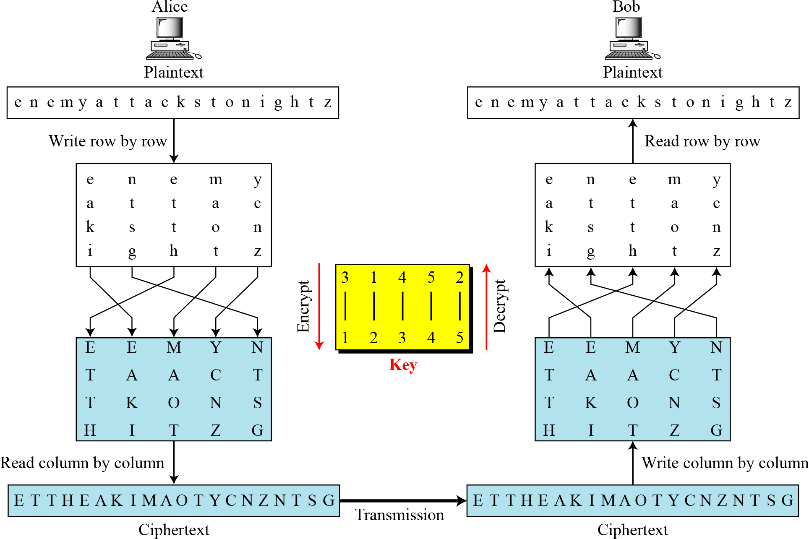
A single key is used in two directions. Downwards for the encryption, upwards for decryption.

Slide 55
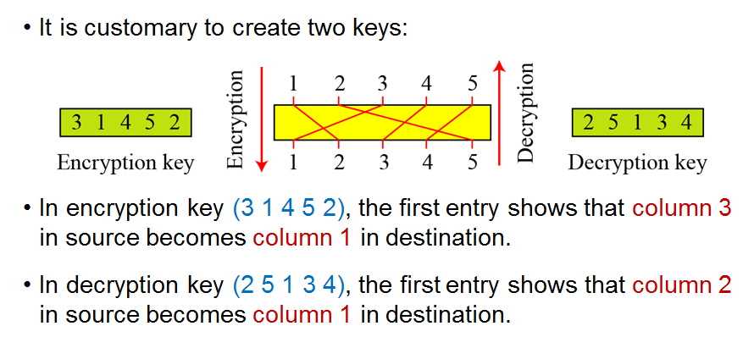
Columnar Transposition Ciphers (Cont.)

Slide 56
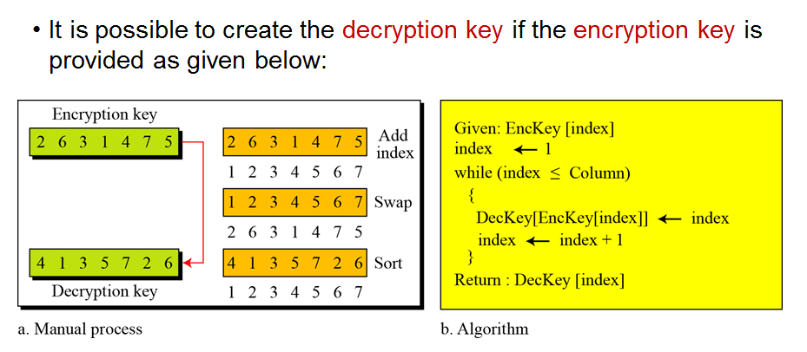
Columnar Transposition Ciphers (Cont.)

Slide 57
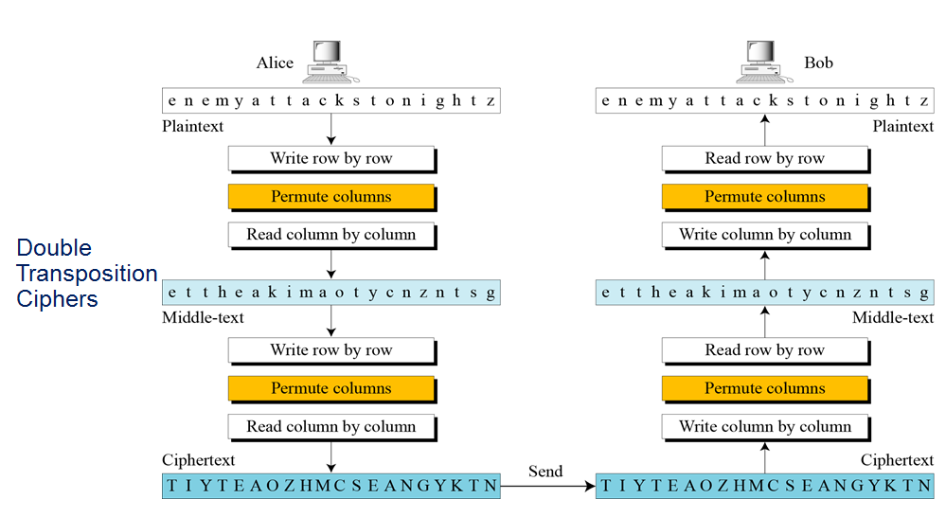

Slide 58
Block Ciphers

Slide 59
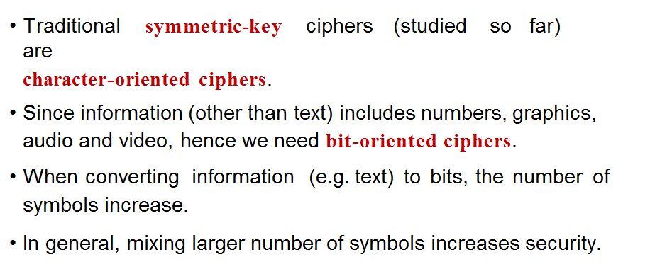
Modern Symmetric-Key Ciphers

Slide 60
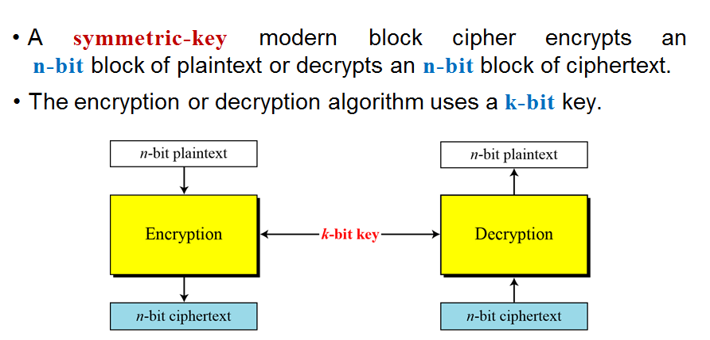
Modern Block Ciphers

Slide 61
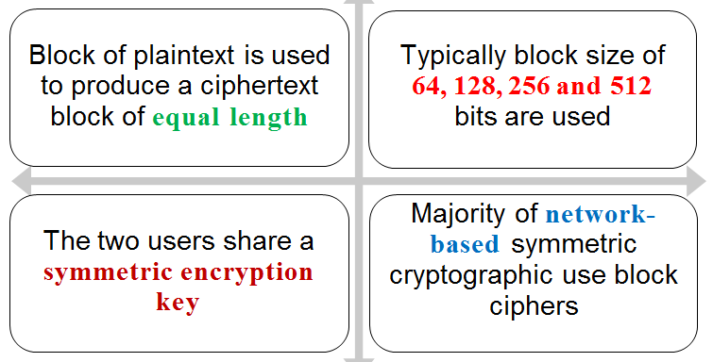
Modern Block Ciphers (Cont.)

Slide 62

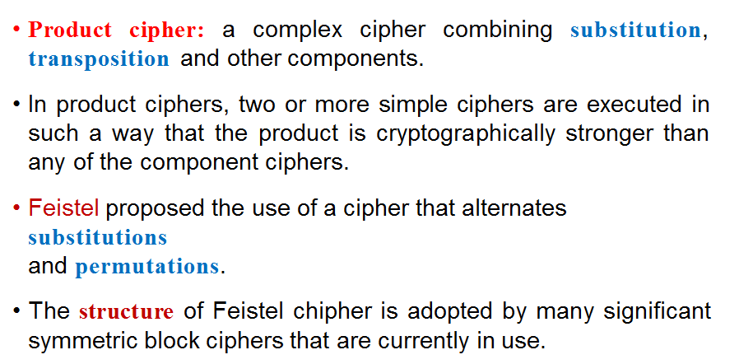
Product Cipher

Slide 63
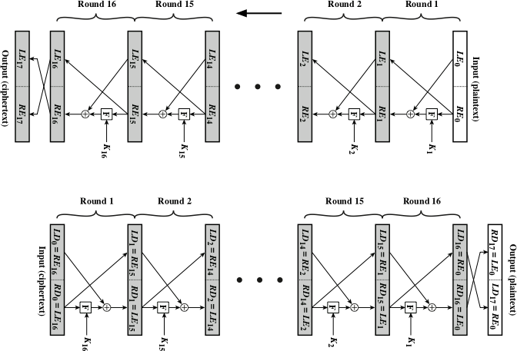

Slide 64
Thank You!

